Slide 1
EN. 601.647/667 Introduction to HLT Deep Learning
Kenton Murray
9/10/2024

Slide 2
EN. 601.647/667 Introduction to HLT Deep Learning
Kenton Murray
9/10/2024
Some slides were inspired by:
Kevin Duh, Shinji Watanabe, Marine Carpaut,
Graham Neubig, Jacob Eisenstein

Slide 3
Let’s try a Chatbot

Slide 4
Agenda
Impact of Deep Learning on HLT
Intro to Deep Learning
What changed? Why recently?
Deep Learning in HLT
PyTorch

Slide 5
Quick Aside
BLEU Scores
Modified n-gram precision metric for Machine Translation
0 – 100.0 (higher is better)
Reviewers generally like ~+1.0 gain over a baseline

Slide 6
Impact of Deep Learning
Liu et al., 2020
Vaswani et al., 2017
BLEU
Sutsekver et al, 2014

Slide 7
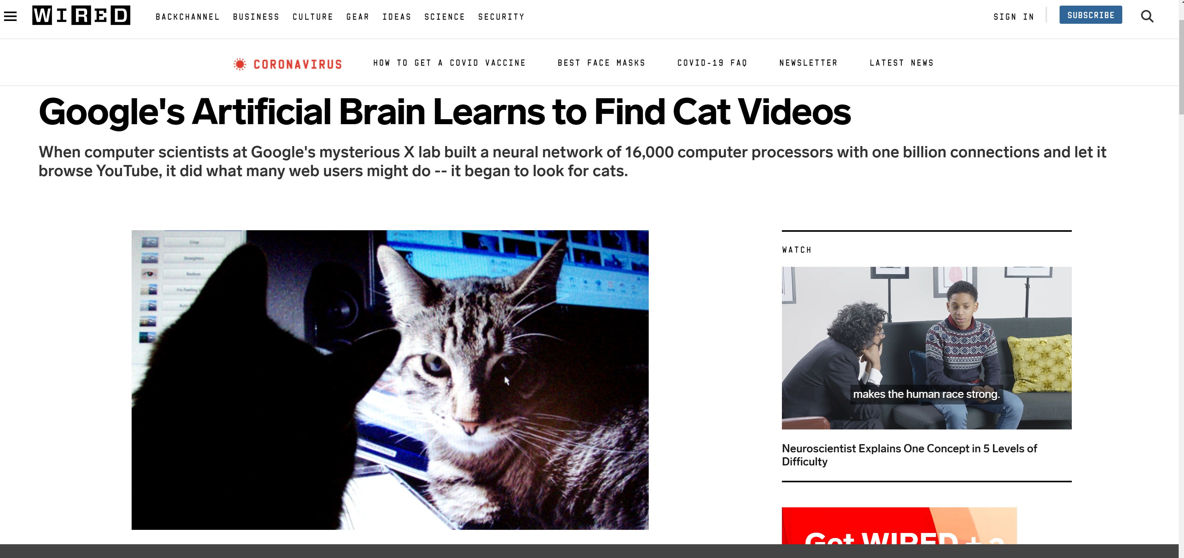
Cats!

Slide 8
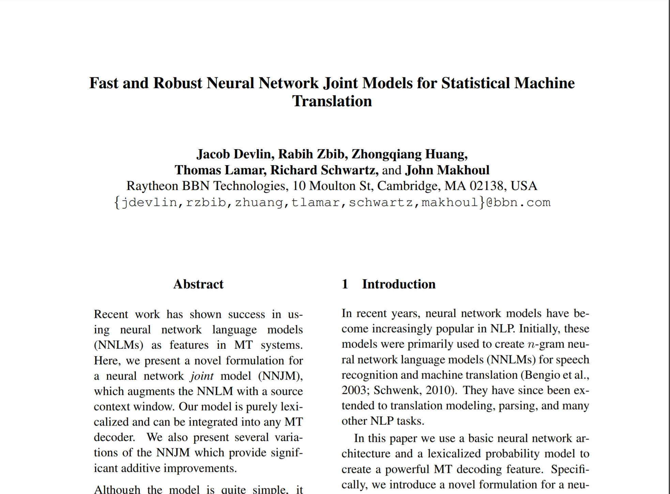
ACL 2014 Best Paper

Slide 9
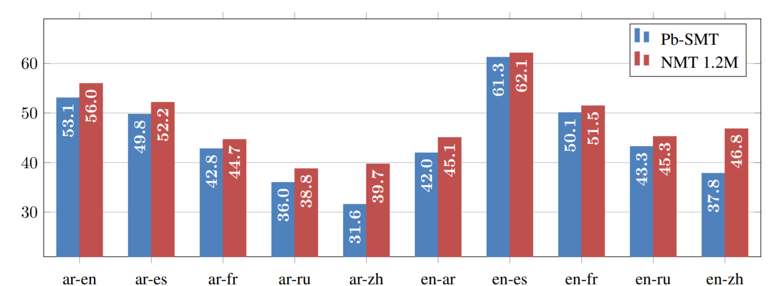
Is Neural Machine Translation Ready for Deployment?
Junczys-Dowmunt et al., 2016

Slide 10
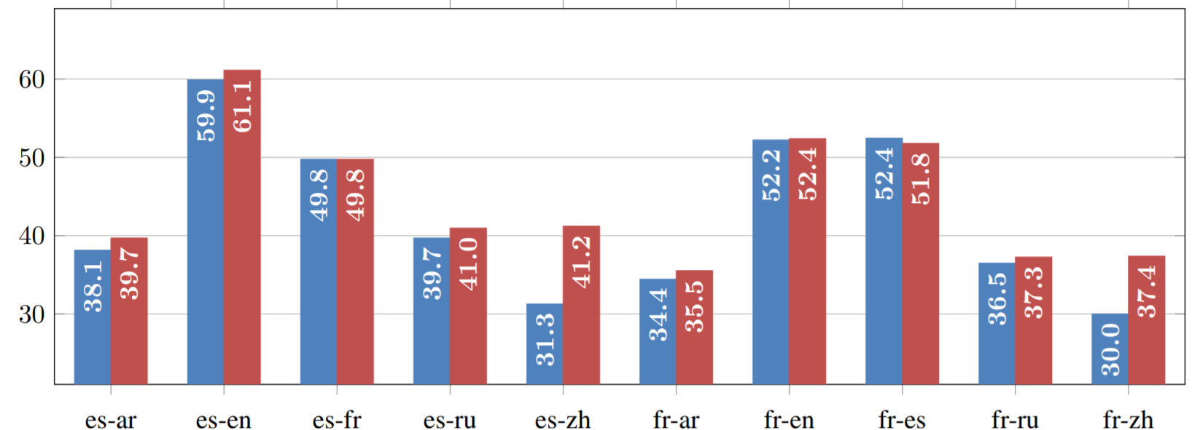
Is Neural Machine Translation Ready for Deployment?
Junczys-Dowmunt et al., 2016

Slide 11
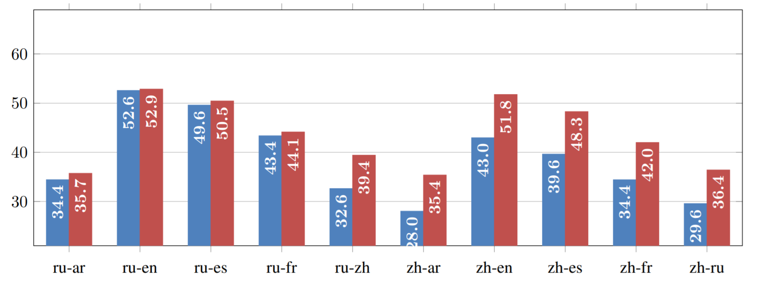
Is Neural Machine Translation Ready for Deployment?
Junczys-Dowmunt et al., 2016

Slide 12
Deep Learning BackGround
Deep Learning is Neural Networks …. That are Deep!

Slide 13
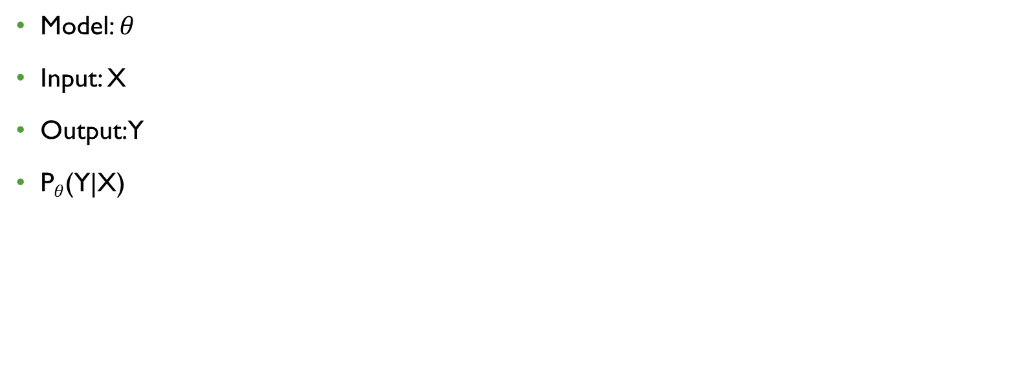
Supervised Learning
Model: $θ$
Input: X
Output: Y
P$θ$(Y|X)

Slide 14
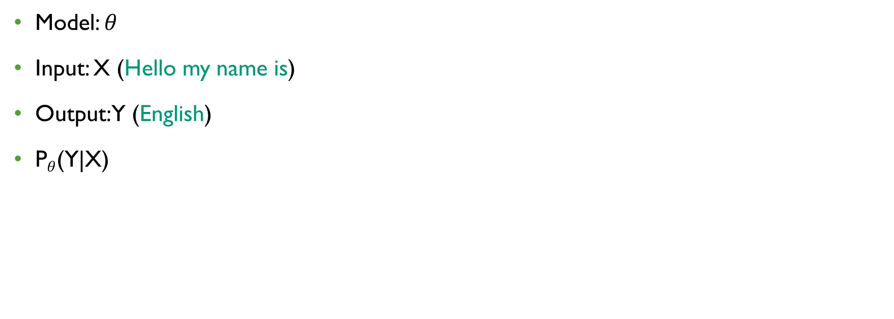
Supervised Learning (Language ID)
Model: $θ$
Input: X (Hello my name is)
Output: Y (English)
P$θ$(Y|X)

Slide 15
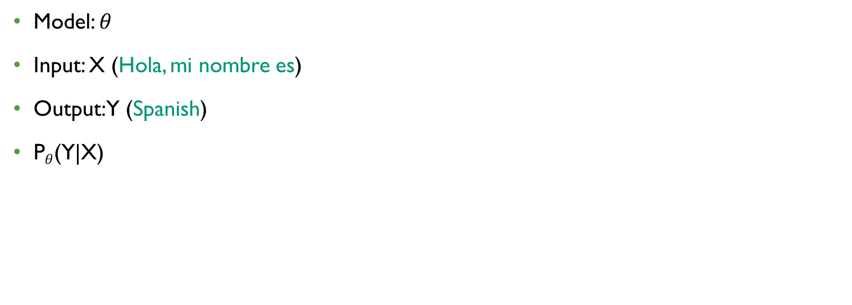
Supervised Learning (Language ID)
Model: $θ$
Input: X (Hola, mi nombre es)
Output: Y (Spanish)
P$θ$(Y|X)

Slide 16
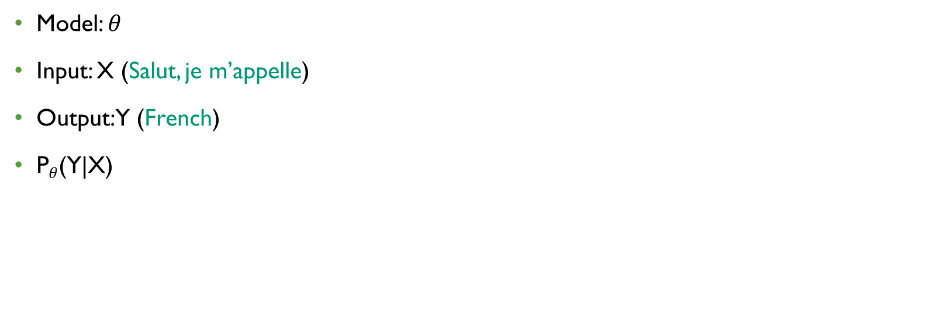
Supervised Learning (Language ID)
Model: $θ$
Input: X (Salut, je m’appelle)
Output: Y (French)
P$θ$(Y|X)

Slide 17
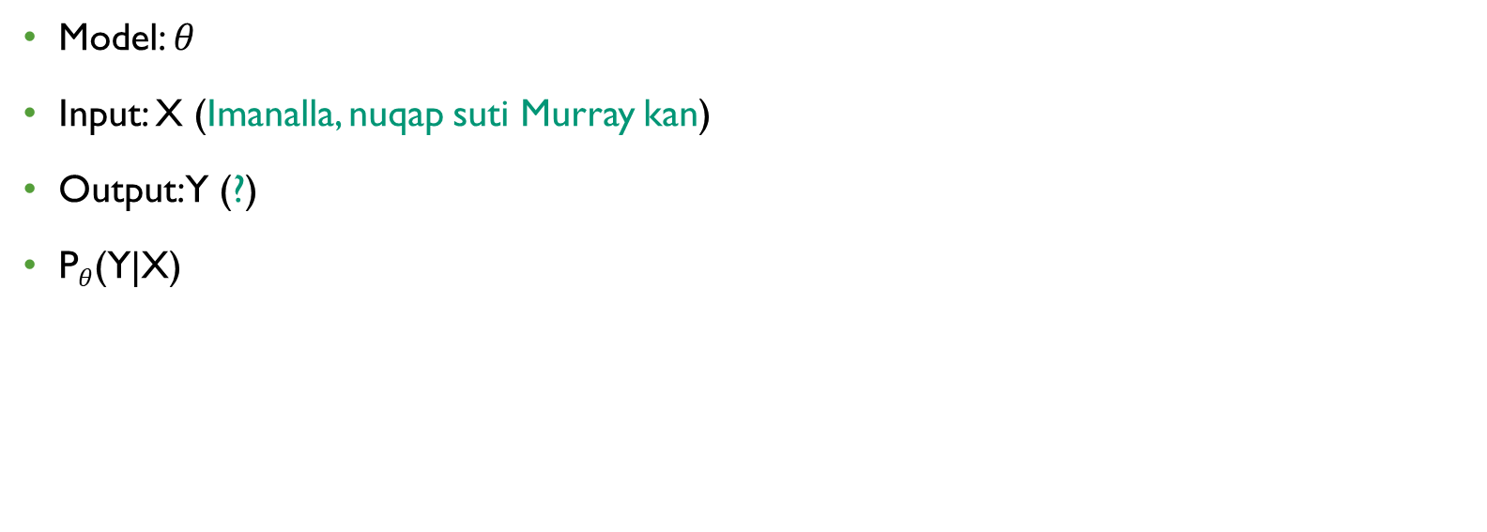
Supervised Learning (Language ID)
Model: $θ$
Input: X (Imanalla, nuqap suti Murray kan)
Output: Y (?)
P$θ$(Y|X)

Slide 18

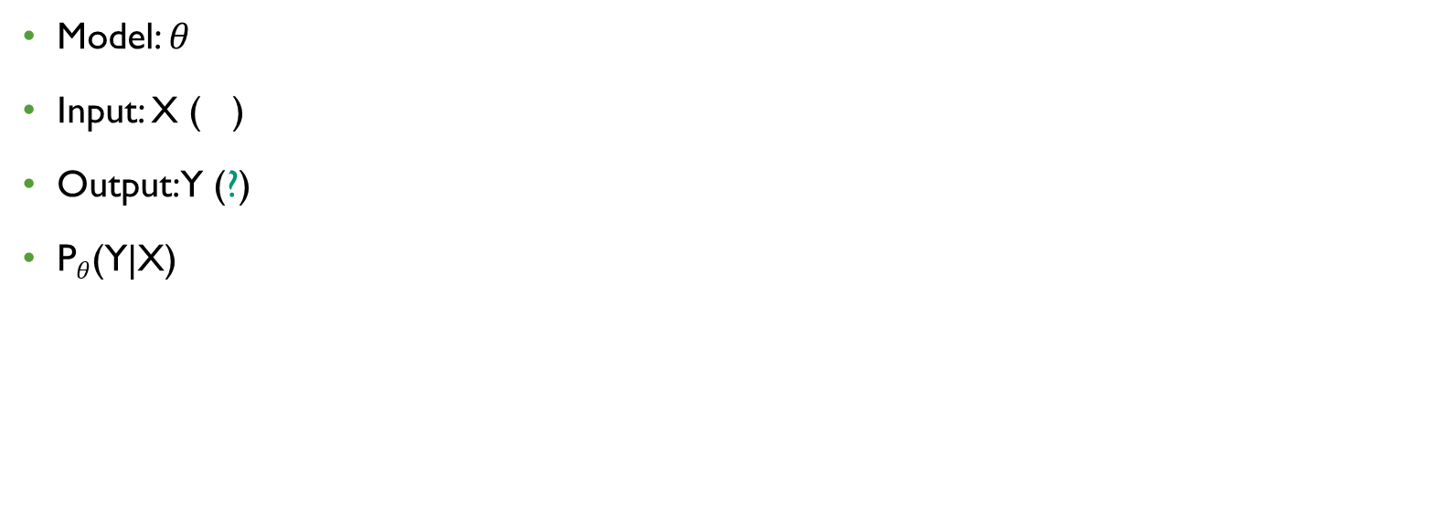
Supervised Learning (Speech Recognition)
Model: $θ$
Input: X ( )
Output: Y (?)
P$θ$(Y|X)

Slide 19
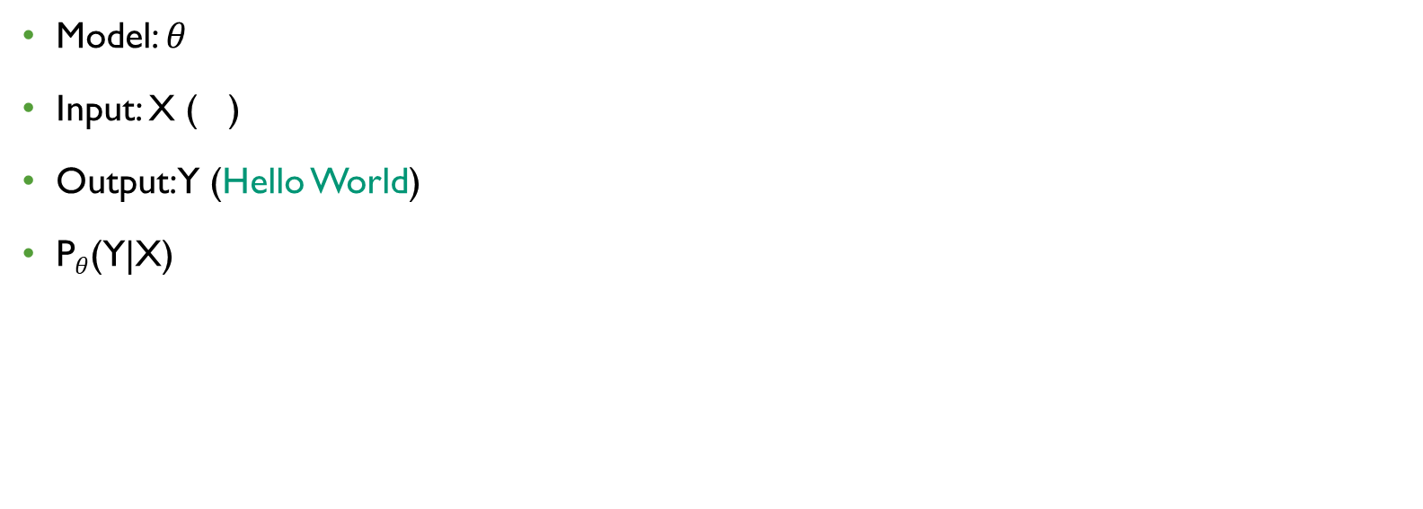
Supervised Learning (Speech Recognition)
Model: $θ$
Input: X ( )
Output: Y (Hello World)
P$θ$(Y|X)

Slide 20

Supervised Learning (Machine Translation)
Model: $θ$
Input: X ( )
Output: Y (?)
P$θ$(Y|X)
مرحبا بالعالم

Slide 21

Supervised Learning (Machine Translation)
Model: $θ$
Input: X ( )
Output: Y (Hello World)
P$θ$(Y|X)
مرحبا بالعالم

Slide 22
Classification
One of the first tasks public thinks of
Sentiment Analysis
Speaker/Writer ID
Language ID
Phoneme Recognition

Slide 23
Binary Classification
j
i

Slide 24
Binary Classification
I
j
Hello
Hola
Me
Gato
Yo
Cat
Gata
i

Slide 25
Binary Classification
I
j
Hello
Hola
Me
Gato
Yo
Cat
Gata
i

Slide 26
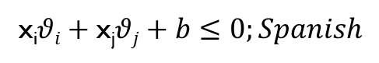
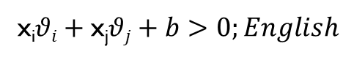
Linear Models
I
j
x_{i}$θi+\text{x}\text{j}θj+b>0;English$
Hello
Hola
x_{i}$θi+\text{x}\text{j}θj+b≤0;Spanish$
Me
Gato
Yo
Cat
Gata
i

Slide 27
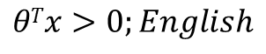
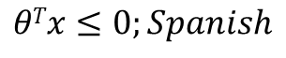
Linear Models
I
j
x_{i}$θi+\text{x}\text{j}θj+b>0;English$
Hello
Hola
x_{i}$θi+\text{x}\text{j}θj+b≤0;Spanish$
Me
$$θTx>0;English$$
$$θTx≤0;Spanish$$
Gato
Yo
Cat
Gata
i

Slide 28
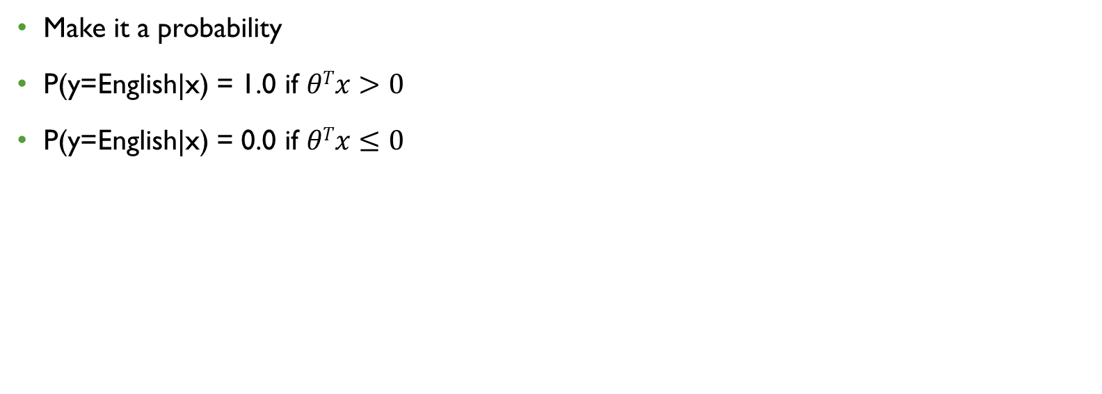
Perceptron
Make it a probability
P(y=English|x) = 1.0 if $θTx>0$
P(y=English|x) = 0.0 if $θTx≤0$

Slide 29
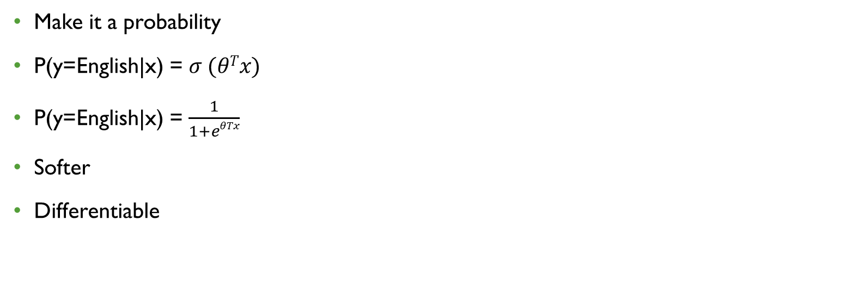
Logistic Regression
Make it a probability
P(y=English|x) = $σ (θTx)$
P(y=English|x) = $\frac{1}{1+eθTx}$
Softer
Differentiable

Slide 30

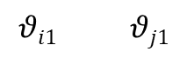
Logistic Regression
Make it a probability
P(y=English|x) = $σ (θTx)$
P(y=English|x) = $\frac{1}{1+eθTx}$
Softer
Differentiable
$$σ$$
$$θi1 θj1$$
x_{i} x_{j}

Slide 31
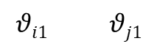
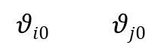

2 Neuron Feed-Forward
$$σ$$
$$σ$$
$$θi1 θj1$$
$$θi0 θj0$$
x_{i} x_{j}

Slide 32
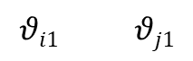



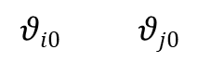

2 Neuron Feed-Forward
$$Spanish$$
$$English$$
Softmax
$$σ$$
$$σ$$
$$θi1 θj1$$
$$θi0 θj0$$
x_{i} x_{j}

Slide 33
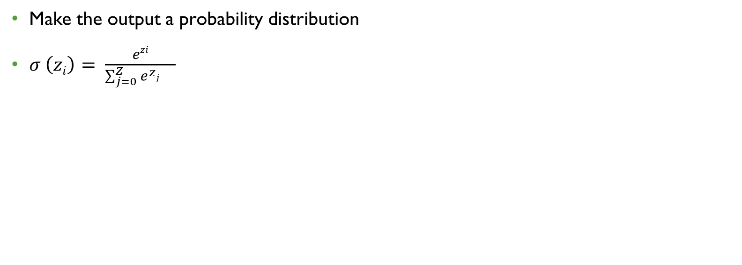
Softmax
Make the output a probability distribution
$σ \left(zi\right)= \frac{ezi}{\sum_{j=0}^{Z}{e^{zj}}{}^{}}$

Slide 34
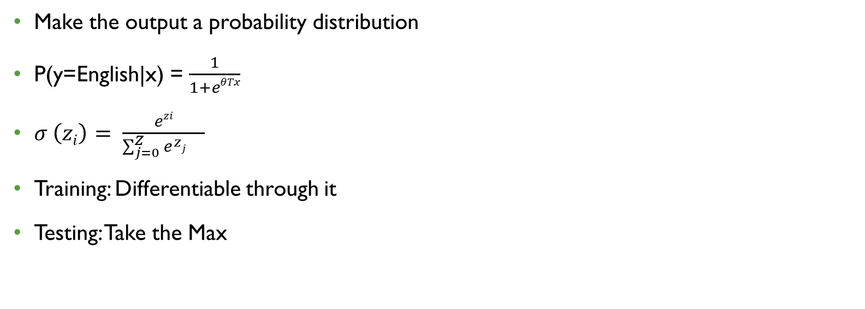
Softmax
Make the output a probability distribution
P(y=English|x) = $\frac{1}{1+eθTx}$
$σ \left(zi\right)= \frac{ezi}{\sum_{j=0}^{Z}{e^{zj}}{}^{}}$
Training: Differentiable through it
Testing: Take the Max

Slide 35
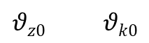
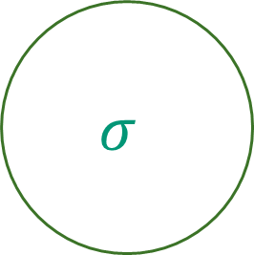

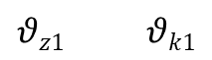
Deep
$$σ$$
$$σ$$
$$θz0 θk0$$
$$θz1 θk1$$
$$σ$$
$$σ$$
$$θi1 θj1$$
$$θi0 θj0$$

Slide 36
Other Non-Linearities
$$σ$$
$$σ$$
$$θi1 θj1$$
$$θi0 θj0$$
x_{i} x_{j}

Slide 37


Other Non-Linearities
$$tanh$$
$$tanh$$
A lot like sigmoid
Range: (-1.0, 1.0)
$$θi1 θj1$$
$$θi0 θj0$$
x_{i} x_{j}

Slide 38
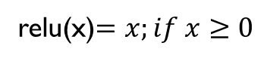

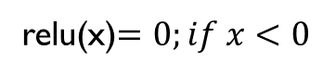

Other Non-Linearities
$$relu$$
$$relu$$
relu(x)$=0;if x<0$
relu(x)$=x;if x≥0$
$$θi1 θj1$$
$$θi0 θj0$$
x_{i} x_{j}

Slide 39
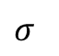

Tensors!
$$σ$$
$θ$/W
X

Slide 40
Tensors!
DEPENDS ON DEFINITION!
$$σ$$
Row: weights into a single neuron
$θ$/W
X

Slide 41
Tensors!
DEPENDS ON DEFINITION!
$$σ$$
Row: weights into a single neuron
$θ$/W
Cols: Number of neurons in layer
X

Slide 42
Why now? (Last 10 years)

Slide 43
Cats!

Slide 44
Cats!

Slide 45
Cats!
GPUs!

Slide 46
Why Now? (Last 10 Years)
Murray and Chiang, 2015
5-gram Language Model ~28 Days CPU (Grid restrictions)
Today ~Couple of hours GPU

Slide 47
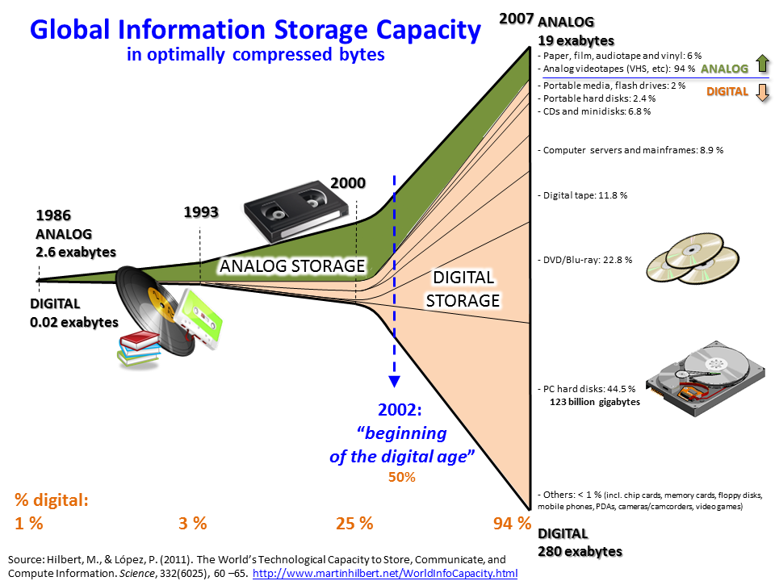
Why Now? (Last 10 Years)
Data availability

Slide 48
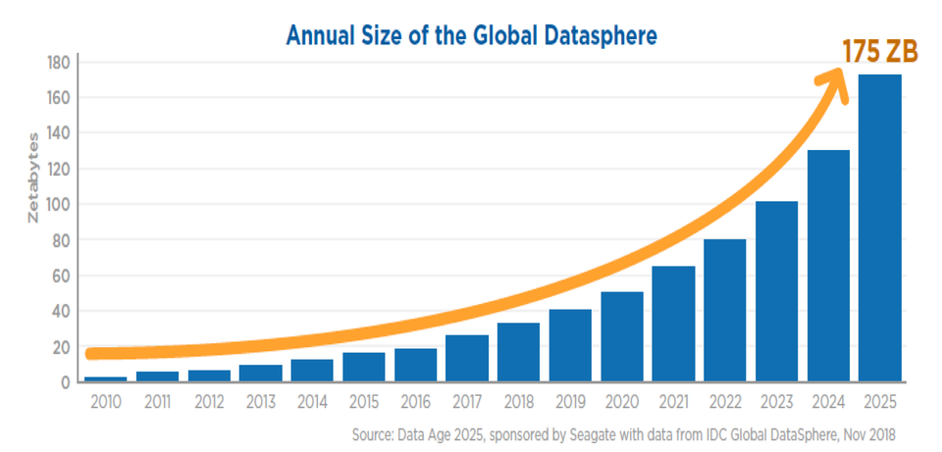
Why Now? (Last 10 Years)
Data availability
Forbes, 2018

Slide 49
Language Models
Throwback to first week
Predict the next word in a sequence

Slide 50

Language Models
Throwback to first week
Predict the next word in a sequence

Slide 51
Language Models
Throwback to first week
Predict the next word in a sequence
Johns Hopkins University was _____

Slide 52
Language Models
Historically: vocab, V
n-gram language model was |V|^{n}
Data Sparsity issues (5-gram was common)
Johns Hopkins University was _____

Slide 53
RNN LMs
Johns Hopkins University was _____
<S> Johns Hopkins University was

Slide 54
RNN LMs
Johns Hopkins University was _____
Vanishing Gradient!
<S> Johns Hopkins University was

Slide 55
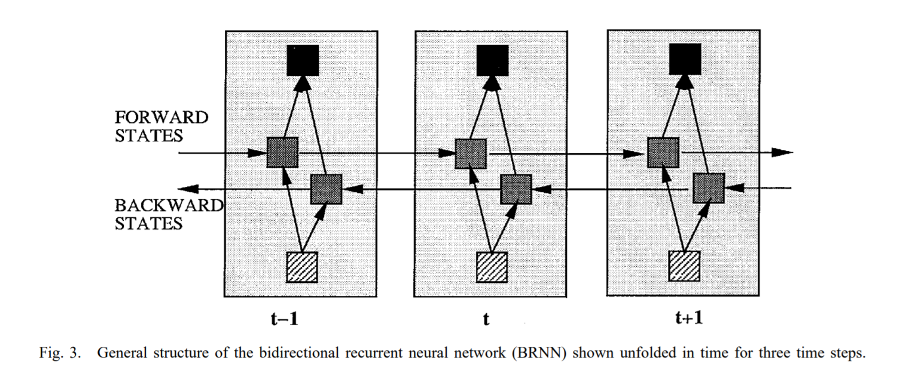
BRNN
Schuster and Paliwal, 1997

Slide 56
LSTMS
Long-Short Term Memory
Cell
Input Gate
Output Gate
Forget Gate
S. Hochreiter and J. Schmidhuber, 1997

Slide 57
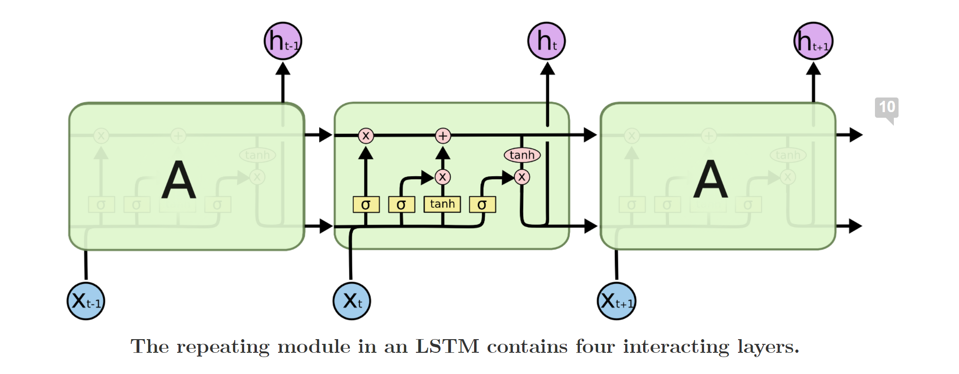
LSTMS
https://colah.github.io/posts/2015-08-Understanding-LSTMs/

Slide 58
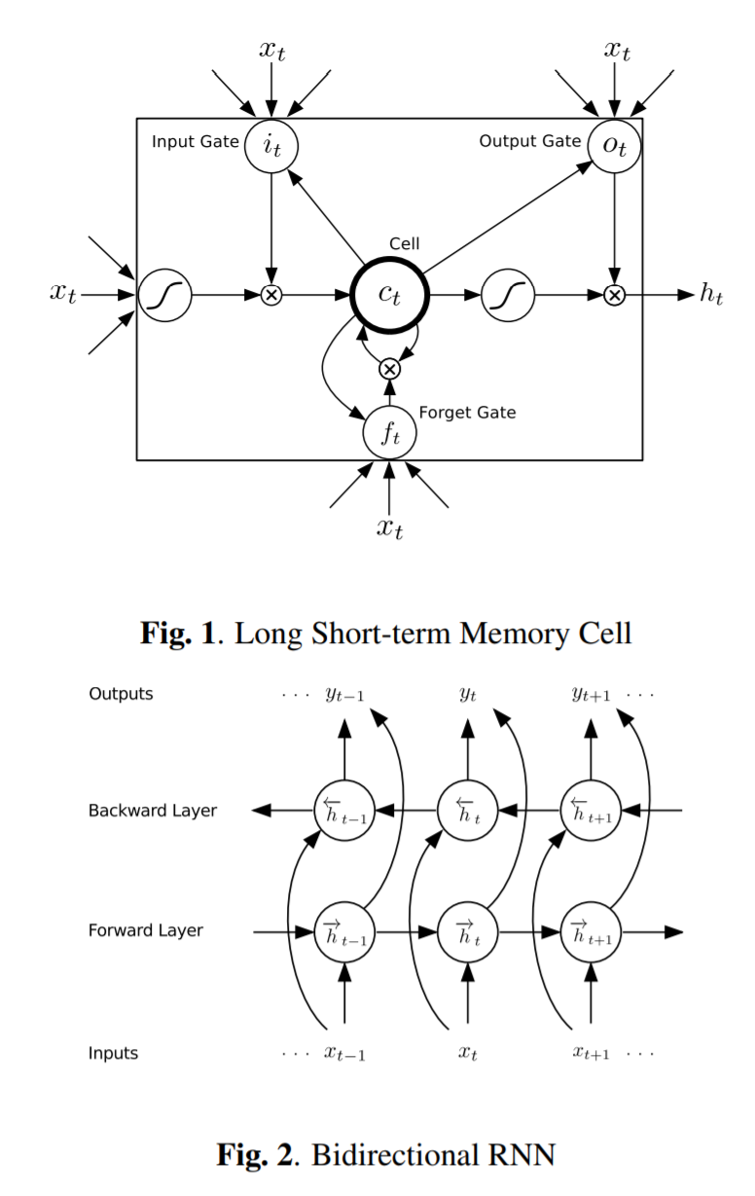
Bi-LSTM
Graves et al., 2013

Slide 59
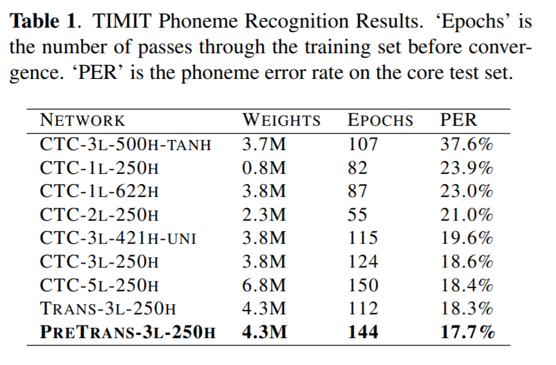
Bi-LSTM
Graves et al., 2013

Slide 60
Machine Translation
Source Sentence, f: “Yo tengo hambre”
Target Sentence, e: “I am hungry”
P(e|f) …….. Neural Network

Slide 61
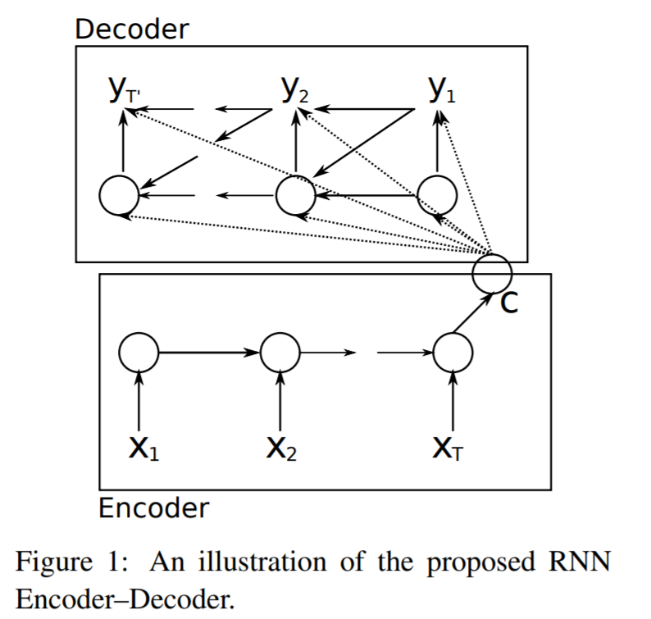
Machine Translation
Cho et al., 2014

Slide 62
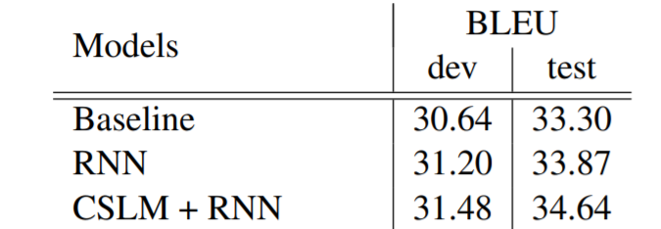
Machine Translation
Cho et al., 2014
WMT ‘14 En-Fr

Slide 63
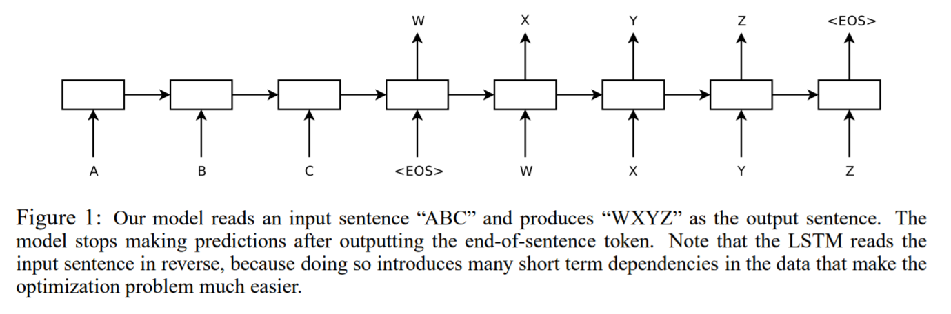
Machine Translation
Sutskever et al., 2014

Slide 64
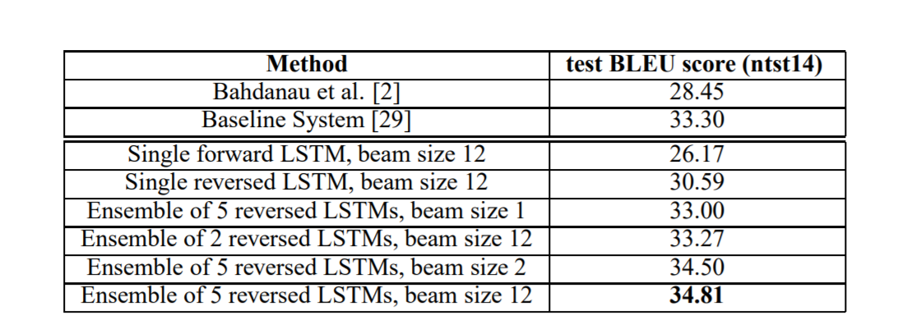
Machine Translation
Sutskever et al., 2014
WMT ‘14 En-Fr

Slide 65
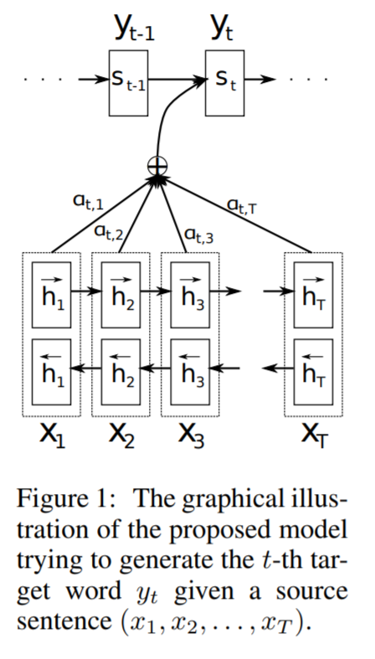
Attention
Bahdanau et al., 2015

Slide 66
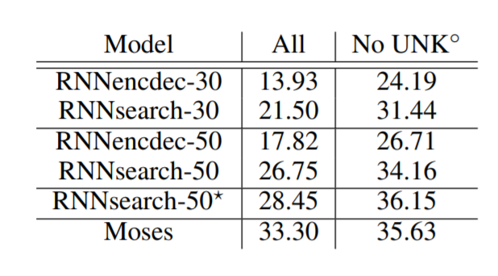
Attention
Bahdanau et al., 2015
WMT ‘14 En-Fr

Slide 67
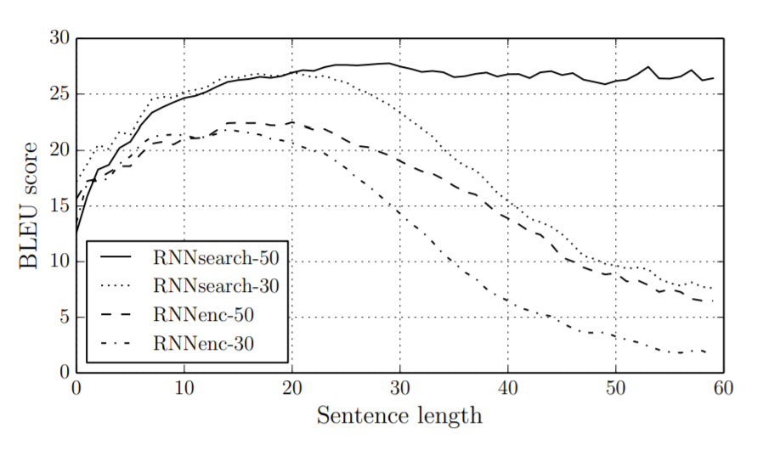
Attention
Bahdanau et al., 2015

Slide 68
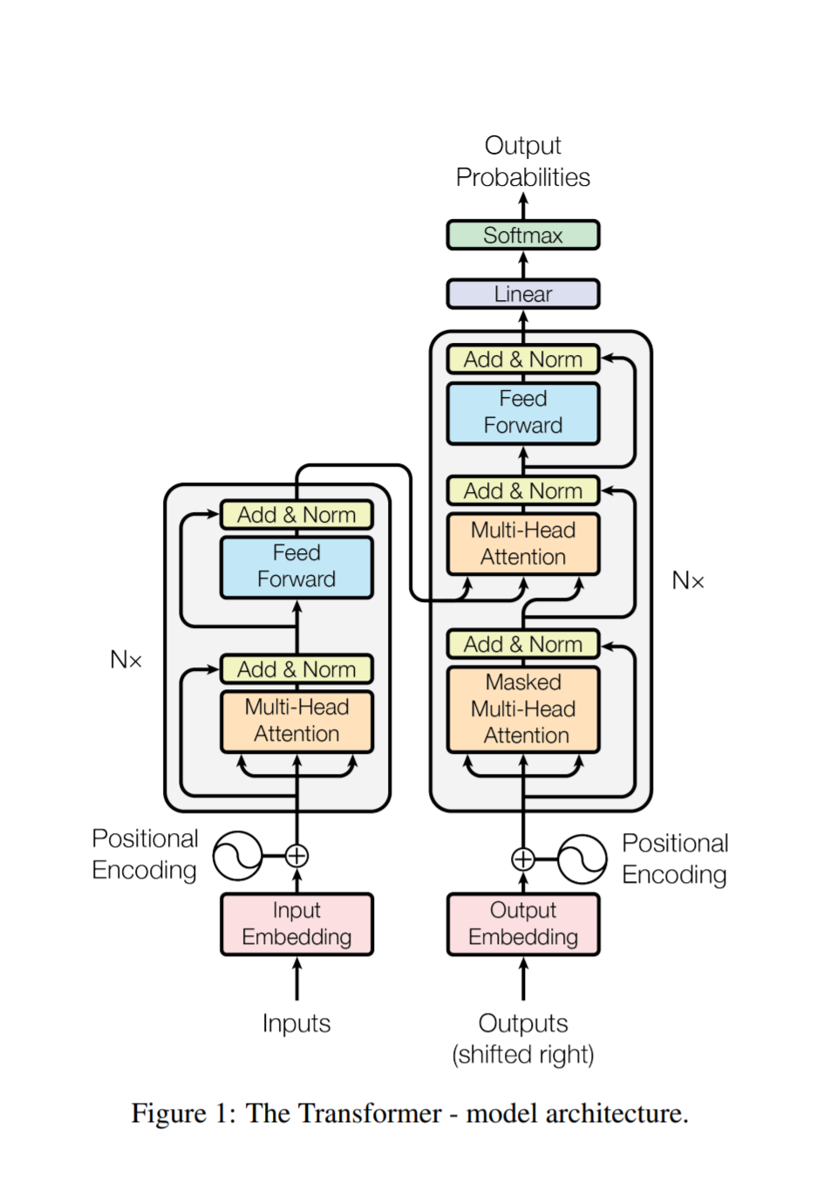
Attention is All You Need
Vaswani et al., 2017
Transformer

Slide 69
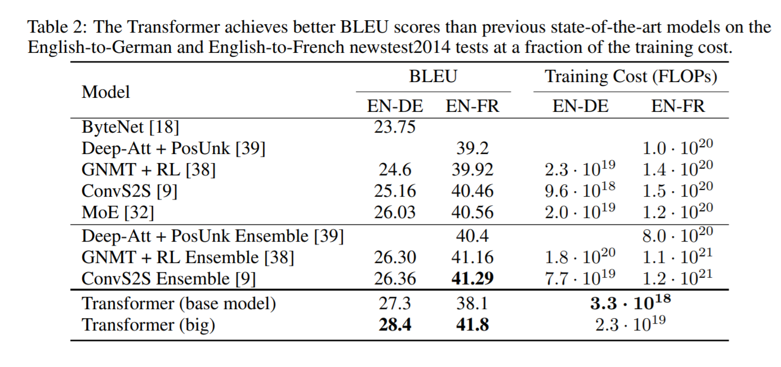
Attention is All You Need
Vaswani et al., 2017

Slide 70

BERT
Devlin et al., 2018
Bidirectional Encoder Representations from Transformers
Masked Language Model

Slide 71
BERT
Johns Hopkins University was _____

Slide 72
BERT
Johns Hopkins University was founded in the year eighteen seventy six .

Slide 73
BERT
Johns Hopkins __________ was founded in the year eighteen _______ six .
Johns Hopkins University was founded in the year eighteen seventy six .

Slide 74
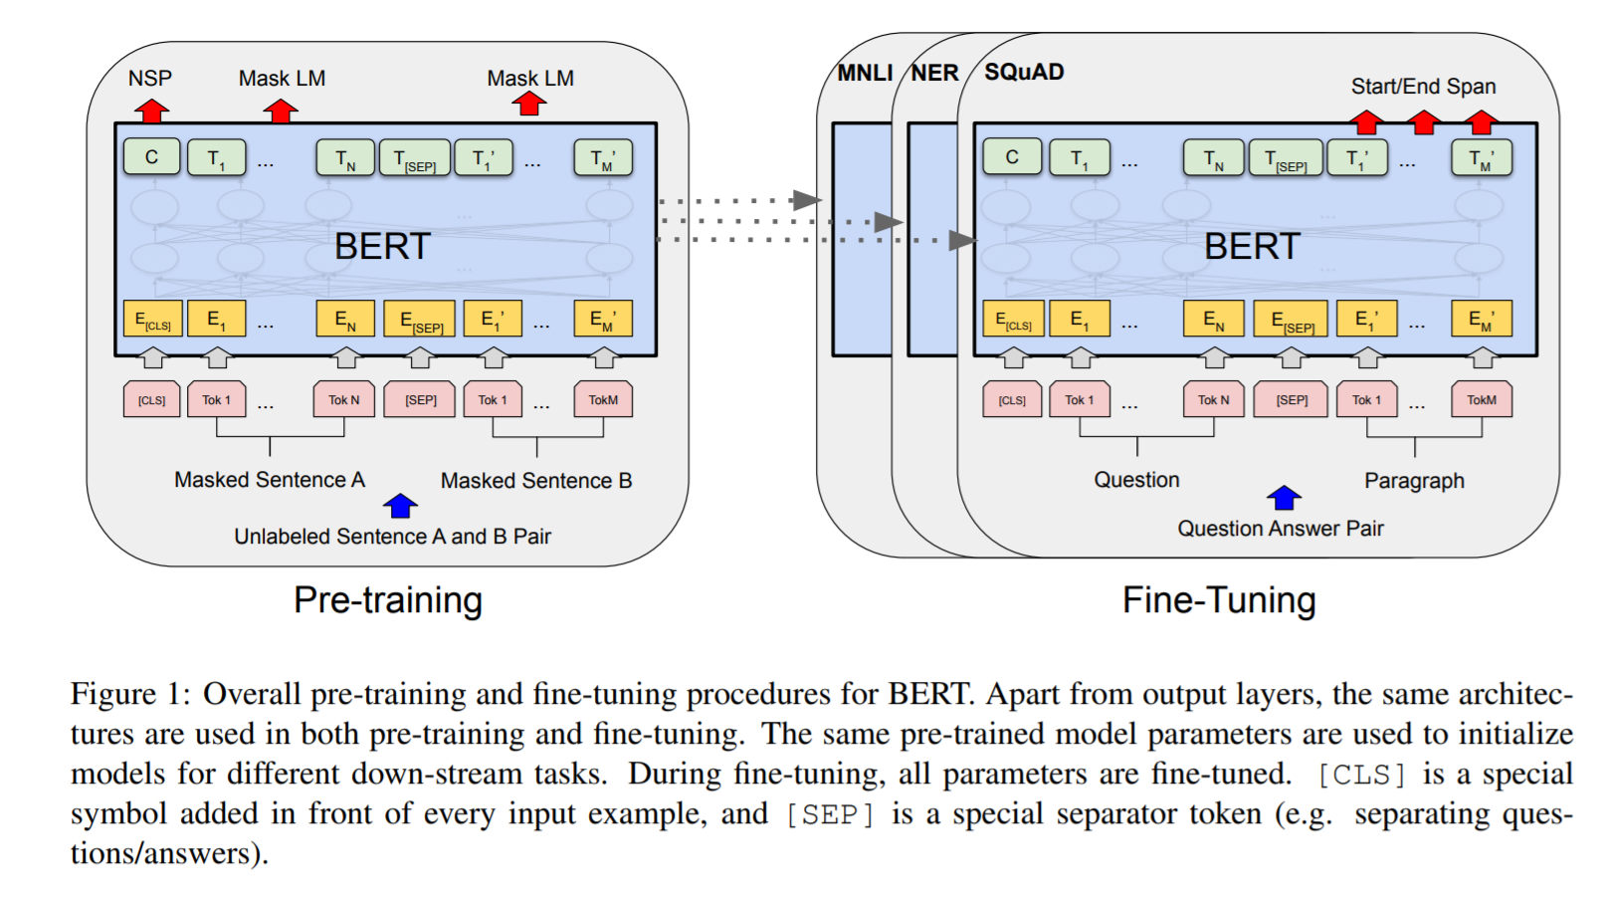
BERT

Slide 75
GPT-3
Brown et al., 2020
Auto-Regressive (Looks to previous context)
Johns Hopkins University was _____

Slide 76
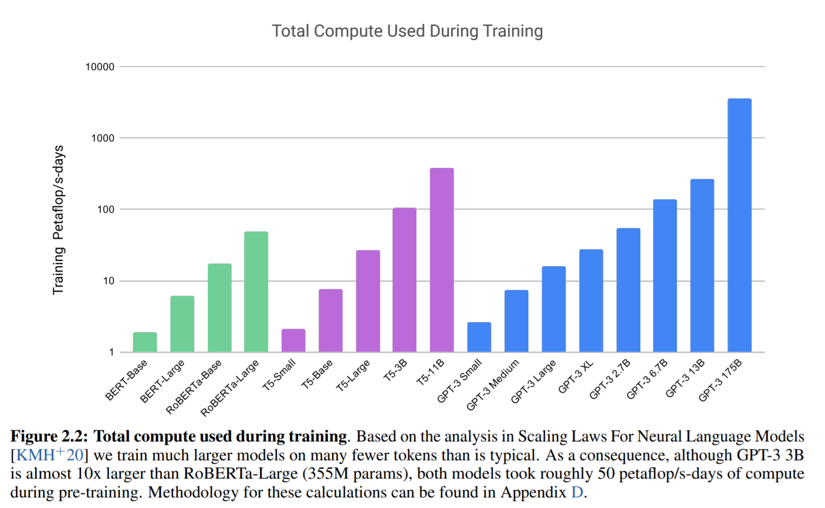
GPT-3

Slide 77
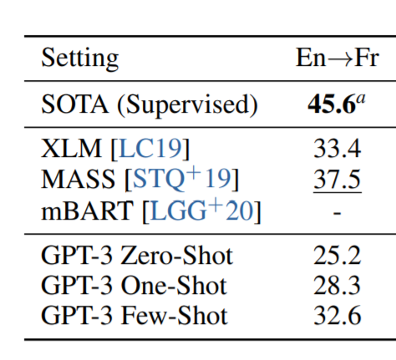
GPT-3
WMT ‘14 MT
SacreBLEU (proper eval)
Trained only on English

Slide 78
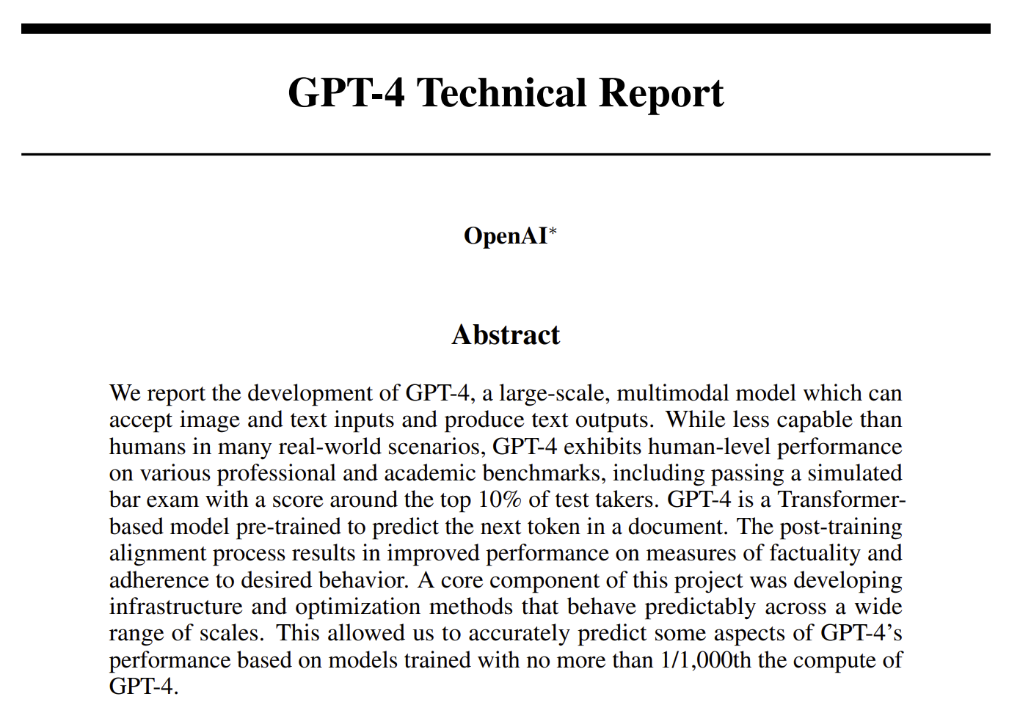
GPT-4

Slide 79


